Slide 1


Provide insights and analysis on OTT platforms Lio Cinema & Jotstar
Resume project challenge #14 conducted by Codebasics
Presented by Ishaa Abdul
Notes:
Hey guys! My name is ishaa abdul and today I will be presenting my Data analysis project which was part of the resume project challenge #14 conducted by codebasics.
"Lio, a leading telecom provider in India, is planning a strategic merger with Jotstar, one of the country’s top streaming platforms. This partnership aims to combine LioCinema’s extensive subscriber base with Jotstar’s diverse content library, setting the stage for a powerful OTT platform."
"To ensure a smooth and successful transition, Lio’s management needs to analyze key aspects of both platforms’ performance over the past year—from January to November 2024. This includes understanding content consumption patterns, subscriber growth trends, inactivity behavior, as well as upgrade and downgrade patterns."
"As the data analyst at Lio, my role is to uncover critical insights from this data to guide informed decision-making. The ultimate goal is to optimize content strategies and position Lio-Jotstar as India’s leading OTT platform."

Slide 2
Agenda
Problem statement
Goal
Data overview
Primary Insights
Secondary insights & recommendations
Thank you note
Notes:
"Let’s go through the agenda for this presentation.
First, I’ll start with the problem statement, where I’ll explain the background of this project and why this analysis is important.
Next, I’ll talk about our key objective—what we aim to achieve through this study and how it will benefit the merged platform.
Then, I’ll walk you through the data models used in this analysis, giving you a quick overview of the underlying structure.
After that, we’ll dive into the main findings. I’ll first highlight the primary insights, followed by some secondary insights that provide additional depth to our analysis.
Finally, I’ll wrap up with recommendations—suggestions that can help both platforms optimize their strategies and successfully move forward post-merger.
So let’s get started!”

Slide 3
Problem Statement
Lio, a leading telecommunications provider in India, is planning a strategic merger with Jotstar, one of the country’s most prominent streaming platforms. This potential partnership aims to combine LioCinema’s expansive subscriber base and Jotstar’s diverse content library to revolutionize digital streaming in India.
Merger goal: Combine Lio Cinema’s subscriber base & Jotstar’s content library.
Objective: Analyze platform performance, user behavior, and trends from January 2024 to November 2024.
Key focus areas:
Content consumption patterns
Subscriber growth and inactivity
Upgrade and downgrade trends
Revenue insights
Outcome: Use data-driven insights to optimize content strategies and make informed decisions post-merger.
Notes:
Lio, a leading telecom provider in India, is planning a strategic merger with Jotstar, one of the country’s top streaming platforms. This partnership aims to combine LioCinema’s extensive subscriber base with Jotstar’s diverse content library, setting the stage for a powerful OTT platform."
"To ensure a smooth and successful transition, Lio’s management needs to analyze key aspects of both platforms’ performance over the past year—from January to November 2024. This includes understanding content consumption patterns, subscriber growth trends, inactivity behavior, as well as upgrade and downgrade patterns."
"As the data analyst at Lio, my role is to uncover critical insights from this data to guide informed decision-making. The ultimate goal is to optimize content strategies and position Lio-Jotstar as India’s leading OTT platform.

Slide 4
Goal
Understand platform performance & user behavior.
Identify trends in content consumption, subscriber growth and inactivity.
Analyze upgrade & downgrade patterns to optimize retention.
Assess revenue impact and profitability.
Use data- driven insights to shape post-merger strategies/
Notes:
The primary goal of this analysis is to provide Lio’s management with data-driven insights that will help in making strategic decisions post-merger."
"We aim to understand platform performance and user behavior, including trends in content consumption, subscriber growth, and inactivity. Additionally, we analyze upgrade and downgrade patterns to optimize customer retention and revenue generation."
"By assessing revenue impact and profitability, we can shape an effective content and pricing strategy, ensuring Lio-Jotstar becomes a market leader in India’s OTT industry."

Slide 5
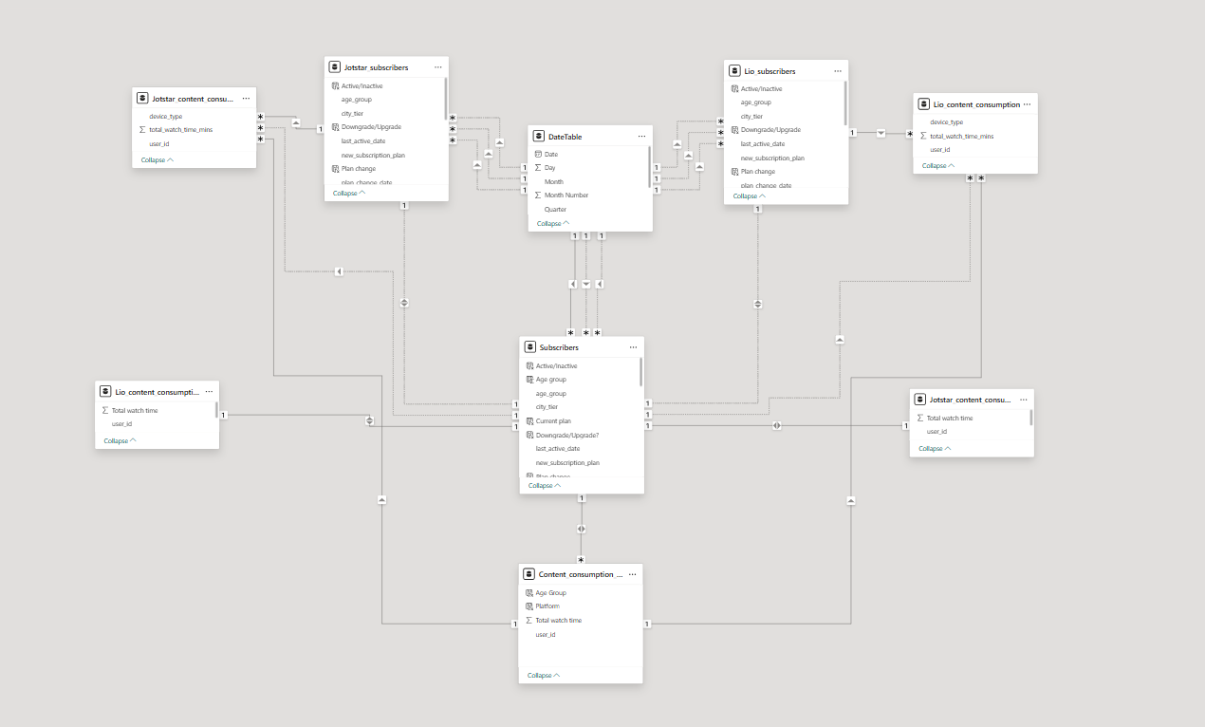
Data overview
Subscriber and content consumption data model
Notes:
Now, let’s take a look at the data model.
The subscriber tables for Lio and Jotstar have been merged into one, ensuring a unified view of the user base. Similarly, the content tables have also been consolidated to give a holistic view of the combined library.
For content consumption, instead of keeping raw data, it has been transformed into a ‘content consumption grouped’ table. This allows us to track total watch hours per user, regardless of the device they used.
Additionally, a date table has been created, which establishes a one-to-many relationship with other fact tables, ensuring smooth time-based analysis across different metrics.”

Slide 6
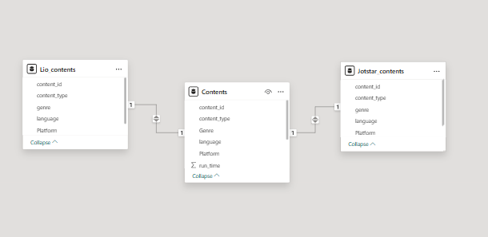
Data overview
Contents data model

Slide 7
Primary Analysis
Q1. Total users & growth trends.
What is the total number of users for LioCinema and Jotstar? How do they compare in terms of growth from January to November 2024?

Slide 8
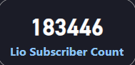
Primary Analysis

Slide 9
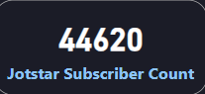
Primary Analysis

Slide 10
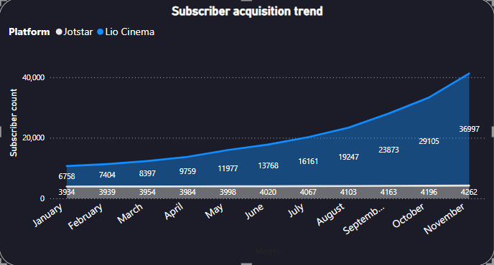
Primary Analysis

Slide 11
Primary Analysis
Month on Month growth of Lio Cinema -25.26%
Month on Month growth of Jotstar- 10.56%
Notes:
Both platforms have shown a steady increase in subscriber count over time.
Jotstar has consistently acquired more subscribers than Lio Cinema, with a significant growth acceleration from June onward.
By November, Jotstar reached 36,997 subscribers, while Lio Cinema remained significantly lower at 4,262 subscribers.
Growth Trend Analysis:
Jotstar: The subscriber base has grown rapidly, particularly from July onwards, with a sharp upward trend visible in the last few months.
Lio Cinema: Growth remains relatively stagnant with only a marginal increase month-over-month.

Slide 12
Primary Analysis
Q2. Content Library Comparison
What is the total number of contents available on LioCinema and Jotstar? How do they differ in terms of language and content type?

Slide 13
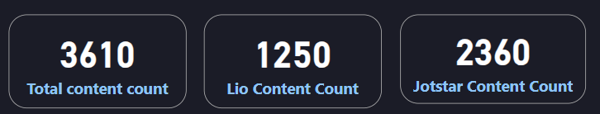
Primary Analysis
Notes:
As we can see, Jotstar has a larger content library than Lio

Slide 14
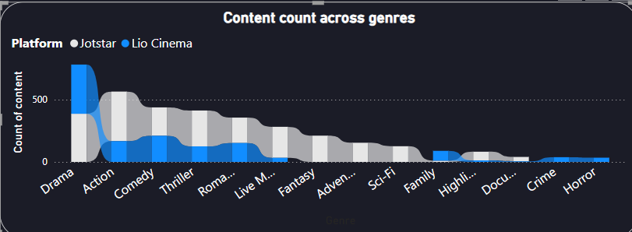
Primary Analysis
Notes:
particularly excelling in the action genre. Moreover, Jotstar offers a more diverse genre distribution, including Fantasy, Adventure, and Documentaries—categories that Lio does not currently feature

Slide 15
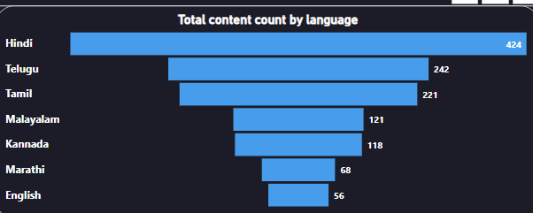
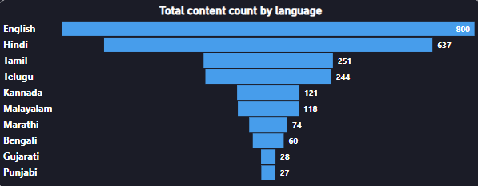
Primary Analysis
Lio Cinema vs Jotstar
Notes:
When analyzing content by language, Jotstar leads with a significant volume of English content, followed by Hindi and Tamil. In contrast, Lio has a much lower proportion of English content.

Slide 16
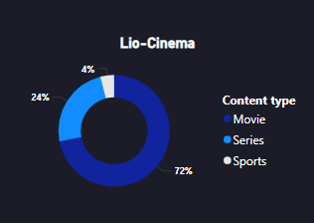
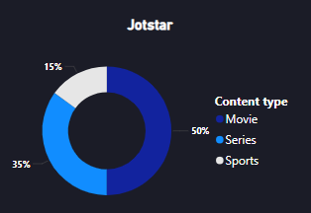
Primary Analysis
Lio Cinema vs Jotstar
Notes:
Now, looking at the content type breakdown—50% of Jotstar’s library consists of movies, followed by series, whereas Lio has a much higher concentration of movies at 72%, with very limited sports content. In comparison, Jotstar dedicates 15% of its library to sports, making it a stronger player in this category.

Slide 17
Primary Analysis
Q3. User demographics
What is the distribution of users by age group, city tier, subscription plan for each platform?

Slide 18
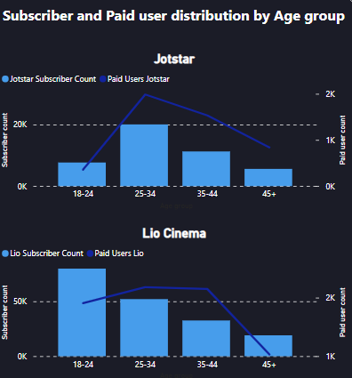
Primary Analysis
Notes:
The user demographics analysis shows that Jotstar's largest subscriber base comes from the 25-34 age group, with nearly 20,000 users. In contrast, Lio Cinema has the highest number of subscribers in the 18-24 age group, with an estimated 80,000 users.
When looking at paid user distribution, both platforms see the highest number of paying subscribers in the 25-34 age group. This suggests that users within this age bracket are more likely to opt for a paid subscription across both OTT platforms.

Slide 19
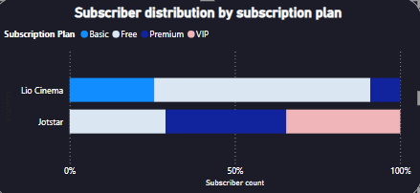
Primary Analysis
Count for Lio Cinema
Free- 119947
Basic- 46880
Premium- 16619
Count for Jotstar
Free- 12943
VIP- 15399
Premium- 16278
Notes:
In terms of subscription plan distribution, Lio Cinema has a higher proportion of free users, while Jotstar has a more diverse distribution across different subscription tiers. Notably, Jotstar has a significant share of VIP subscribers, which is absent in Lio Cinema’s model. This indicates that Jotstar has a stronger premium monetization strategy, whereas Lio relies more on free-tier users. • Lio Cinema has a higher proportion of free users, with only a small percentage opting for premium or VIP plans.
• Jotstar, however, has a more balanced distribution, with a notable percentage of subscribers in the premium and VIP categories.
• The VIP segment is exclusive to Jotstar, indicating a differentiated content offering or monetization strategy.
• This highlights that Jotstar is relatively stronger in converting users into premium subscribers, whereas Lio Cinema relies more on free-tier users.

Slide 20
Primary Analysis
Q4. Active vs Inactive trends
What percentage of both OTTs are active and inactive? How do these rates vary with age and subscription plan?

Slide 21
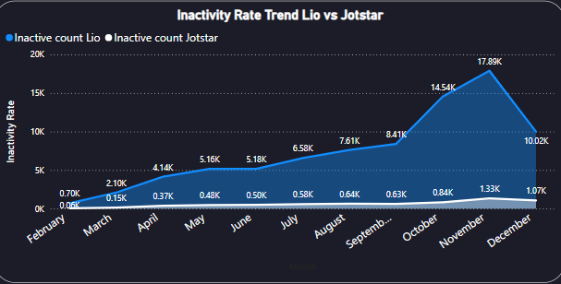
Primary Analysis

Slide 22
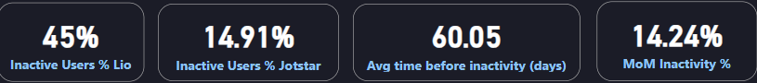
Primary Analysis
Notes:
Lio Cinema shows a much higher inactivity rate, reaching a peak of 17.89K inactive users in November before dropping to 10.02K in December.
Jotstar maintains a consistently low inactivity rate, indicating better engagement and retention.
Key Metrics:
Lio Inactivity Rate: 45% of users become inactive.
Jotstar Inactivity Rate: Significantly lower at 14.91%.
Average time before inactivity: 60 days, meaning most users disengage within two months of subscribing.
MoM Inactivity Growth: 14.24%, showing an increasing trend in churn that needs to be addressed.
Key Takeaway: Lio Cinema has a major challenge with user retention, while Jotstar is comparatively better at keeping users engaged.

Slide 23
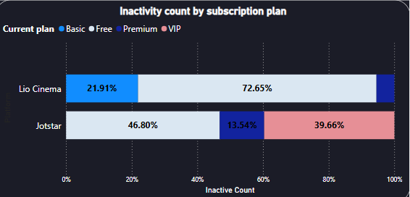
Primary Analysis

Slide 24
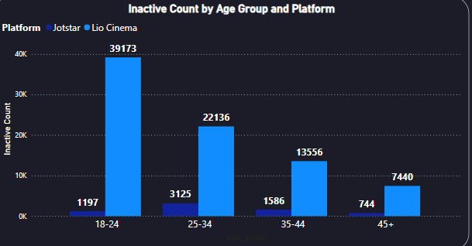
Primary Analysis
Notes:
• The 18-24 age group shows the highest inactivity for Lio Cinema, with 39,173 inactive users, whereas Jotstar has only 1,197 inactive users in this category.
• The 25-34 age group follows next, with 22,136 inactive users for Lio Cinema, while Jotstar remains significantly lower at 3,125 inactive users.
Lio Cinema struggles with retaining younger audiences, particularly 18-24-year-olds. Jotstar has better engagement and lower inactivity rates across all demographics.
Retention strategies for Lio Cinema should focus on younger users to reduce churn.

Slide 25
Primary Analysis
Q5.Watch time analysis
What is the average watch time for LioCinema vs. Jotstar during the analysis period? How do these compare by city tier and device type?

Slide 26
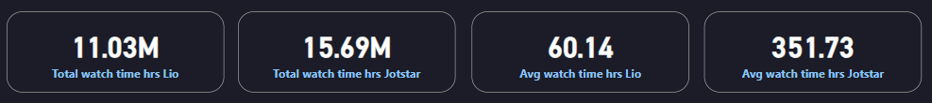
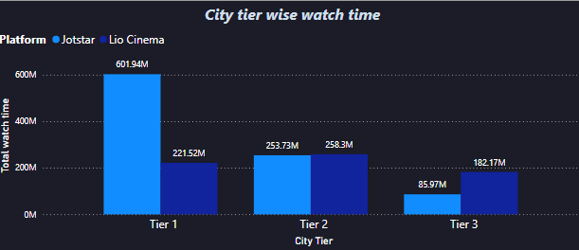
Primary Analysis
Notes:
• City Tier Analysis:
Tier 1 cities have the highest total watch time, with Jotstar dominating in this segment.
Tier 2 and Tier 3 cities show a more balanced watch time distribution between the two platforms.

Slide 27
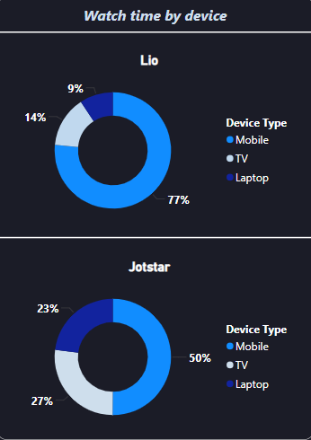
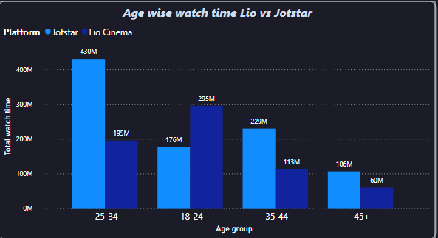
Primary Analysis
Notes:
Device Usage:
Lio Cinema users predominantly watch content on mobile (77%), with minimal engagement on laptops (9%).
Jotstar users have a more diverse viewing pattern, with 50% on mobile, 27% on laptops, and 23% on TV.

Slide 28
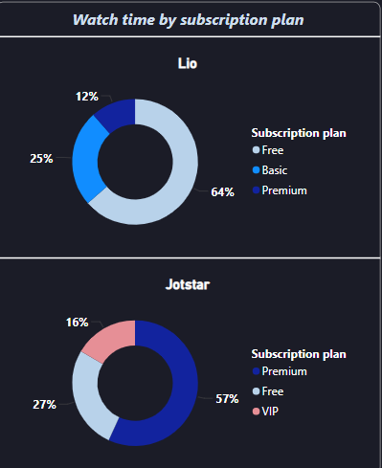
Primary Analysis
Notes:
Lio Cinema sees the highest watch time from free users (64%), while premium users make up 25%.
• Jotstar’s watch time is more balanced, with 57% from premium users and 27% from free users, showing better monetization potential.

Slide 29
Primary Analysis
Q6. Inactivity correlation
How do inactivity patterns correlate with total watch time or average watch time? Are less engaged users more likely to become inactive?

Slide 30
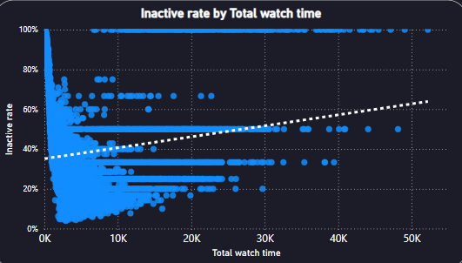
Primary Analysis
Notes:
The scatter plot shows a negative correlation at lower watch times but a slight upward trend overall.
• Users with lower total watch time tend to have a higher inactivity rate, often close to 100%.
• As total watch time increases, the inactivity rate decreases, but there are still some outliers with high inactivity even at higher watch times.
• The trend line suggests a slight increase in inactivity rate at higher watch times, which might indicate periodic or seasonal engagement patterns.
• This could mean that users who engage more still have phases of inactivity, possibly due to subscription expirations, content availability, or competition from other platforms.

Slide 31
Primary Analysis
Q7. Downgrade trends
How do downgrade trends differ between LioCinema and Jotstar? Are downgrades more prevalent on one platform compared to the other?

Slide 32
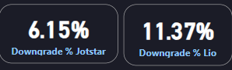
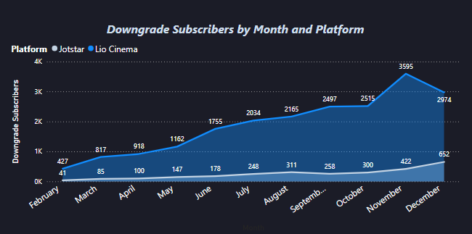
Primary Analysis
Notes:
Lio Cinema has a significantly higher downgrade rate (11.37%) compared to Jotstar (6.15%).
• The number of downgraded users increased steadily for both platforms, peaking in December.
• Jotstar had a lower downgrade count throughout the year, maintaining a stable user base.
• Lio Cinema saw a major spike in downgrades from October to December, jumping from 2.5K to nearly 3.6K in November before slightly declining in December (2.97K).

Slide 33
Primary Analysis
Q8. Upgrade trends
What are the most common upgrade transitions (e.g., Free to Basic, Free to VIP, Free to Premium) for LioCinema and Jotstar? How do these differ across platforms?

Slide 34
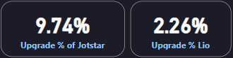
Primary Analysis

Slide 35

Primary Analysis

Slide 36
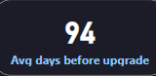
Primary Analysis

Slide 37
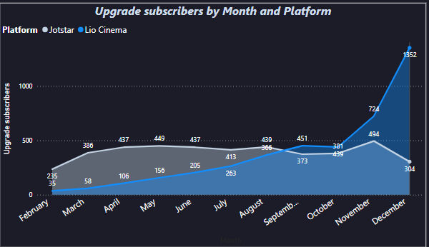
Primary Analysis
Notes:
Jotstar has a much higher upgrade rate (9.74%) compared to Lio Cinema (2.26%), suggesting stronger customer satisfaction or better incentives.
• December saw a massive spike in upgrades (1352 for Jobstar, 304 for Lio), possibly due to promotions, content releases, or seasonal factors.
• The most upgraded plans were:
Jobstar: Free → Premium
Lio Cinema: Basic → Premium
• The average time before upgrading is 94 days, indicating a waiting period before users commit to paid plans.

Slide 38
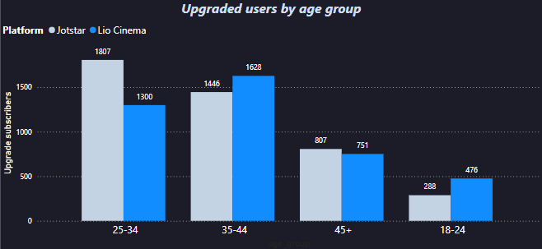
Primary Analysis
Notes:
Ages 25-34 are the most active in upgrading, with Jotstar (1807) leading over Lio Cinema (1300).
• Users aged 35-44 also upgrade frequently, slightly favoring Lio Cinema (1628) over Jobstar (1446).
• Older users (45+) and younger users (18-24) show lower upgrade rates, indicating that middle-aged users are the most likely to invest in premium plans. •

Slide 39
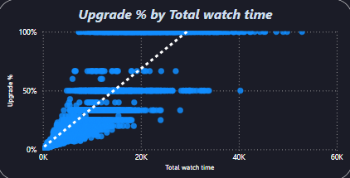
Primary Analysis
Notes:
Higher watch time correlates with higher upgrade rates, suggesting that engaged users see value in premium plans.
• Inactive rate is highest among low-watch-time users, implying a need for better engagement strategies to retain casual viewers.

Slide 40
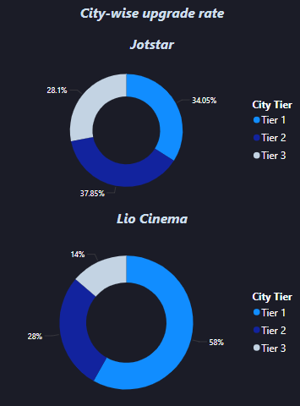
Primary Analysis
Notes:
Lio Cinema upgrades are dominated by Tier 1 cities (58%), followed by Tier 2 (28%) and Tier 3 (14%). This suggests that Lio Cinema's premium offerings attract more urban users.
Jobstar, on the other hand, has a more even distribution, with upgrades from Tier 1 (34.05%), Tier 2 (37.85%), and Tier 3 (28.1%).
This indicates that Lio Cinema has a stronger presence in metro areas, whereas Jobstar appeals more evenly across all city tiers.

Slide 41
Primary Analysis
Q9. Paid users distribution
How does the paid user percentage vary across different platforms?

Slide 42
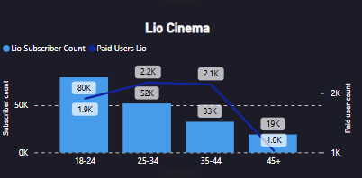
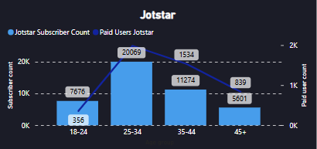
Primary Analysis
Notes:
Jotstar:
Majority of paid users fall in the 25-34 age group (~20K users).
The 18-24 and 45+ groups have significantly lower paid subscribers.
Lio Cinema:
The highest subscriber count is in the 18-24 age group (~80K users), but only 1.9K are paid users.
25-34 and 35-44 groups have a relatively balanced paid subscriber count (~2.2K and ~2.1K, respectively).
Lio has a lower penetration of paid users compared to total subscribers in younger audiences.

Slide 43
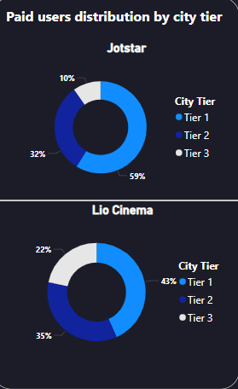
Primary Analysis
Notes:
Jotstar:
59% of paid users are from Tier 1, with 32% from Tier 2 and only 10% from Tier 3.
This indicates Jotstar's stronghold in premium urban markets with fewer users from lower-tier cities.
Lio Cinema:
More balanced distribution with 43% from Tier 1, 35% from Tier 2, and 22% from Tier 3.
Lio Cinema has a wider reach across lower-tier cities, making it more accessible outside major metro areas.
Jotstar dominates in Tier 1 cities and higher-paid subscriptions ✅ Lio Cinema has a broader reach in lower-tier cities but struggles to convert free users into paying customers ✅ Jotstar's paid users are concentrated in the 25-34 age group, while Lio’s user base is younger but less willing to pay

Slide 44

Primary Analysis
Notes:
Jotstar:
Has a significant VIP user base, indicating a preference for premium plans.
More users are on higher-end subscriptions compared to Lio Cinema.
Lio Cinema:
More users on Basic and Free plans than Jotstar.
Shows that Lio attracts a larger volume of users but struggles with premium conversions.

Slide 45
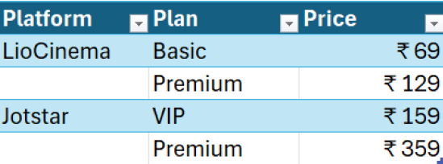
Primary Analysis
Q10. Revenue Analysis
Assume the following monthly subscription prices, calculate the total revenue generated by both platforms (LioCinema and Jotstar) for the analysis period (January to November 2024).

Slide 46
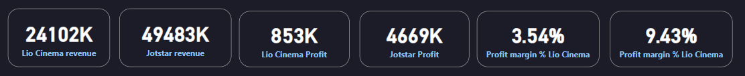
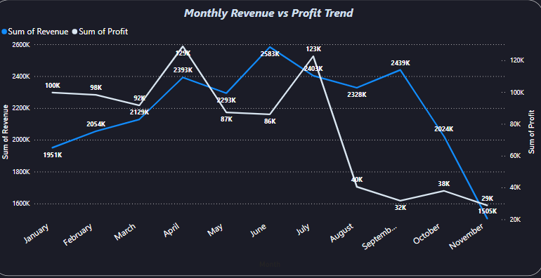
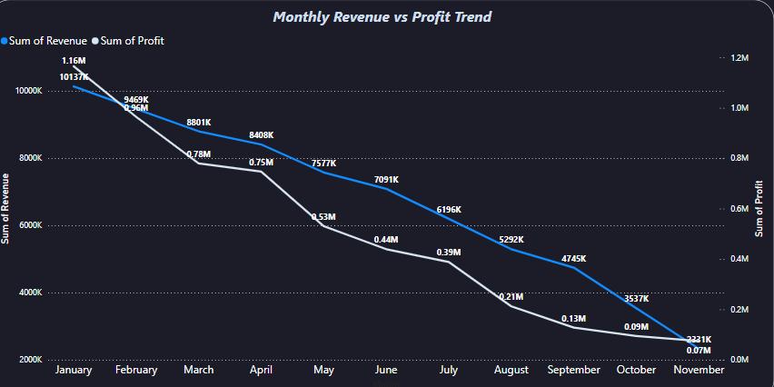
Primary Analysis
Lio Cinema vs Jotstar
Notes:
Jotstar’s revenue and profit have consistently declined from January (Revenue: 1.16M, Profit: 1.01M) to November (Revenue: 321K, Profit: 70K). A sharp drop occurred between April and June, with the biggest profit decline from May (530K) to June (390K). Q4 saw critical losses, with November marking the lowest revenue and profit figures.
Unlike Jotstar, Lio Cinema’s revenue and profit fluctuated, peaking in April (2.39M), June (2.58M), and October (2.43M), likely due to seasonal demand or promotions. However, profit dropped sharply from 123K in July to just 10K in September, while revenue declined from 2.58M in June to 1.50M in November. Despite stronger performance than Jotstar for most of the year, both platforms saw declining numbers by Q4, possibly due to rising competition or market shifts.

Slide 47
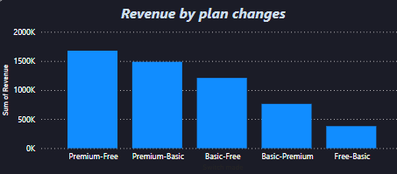
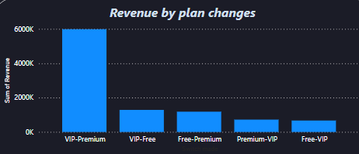
Primary Analysis
Lio Cinema vs Jotstar

Slide 48
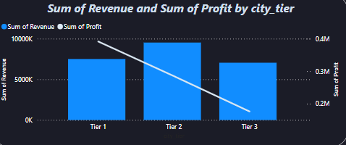
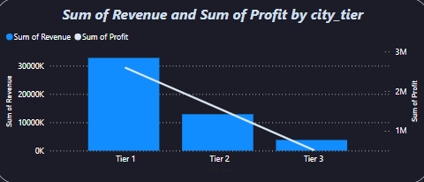
Primary Analysis
Lio Cinema vs Jotstar

Slide 49
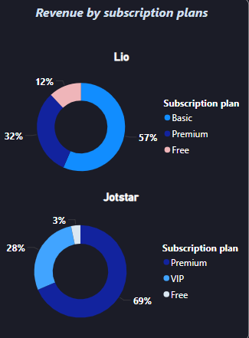
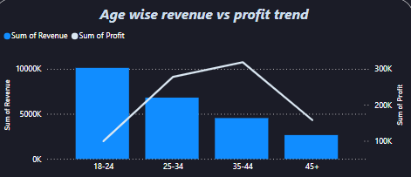
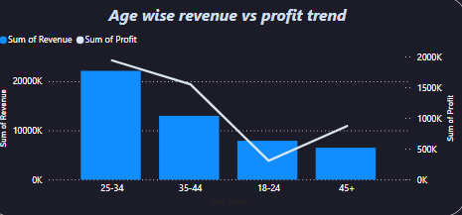
Primary Analysis
Lio Cinema
Jotstar

Slide 50
Recommendations
1. What strategies can the merged platform implement to increase engagement among inactive users and convert them into active users?
Give rewards or points for each movie/show completed. We can also do the same for watch hours and then at the end of the year rewards with mini Amazon coupons.
Introduce limited offers which they can avail.
Encourage watch parties (so they can invite friends/family and engage more)
2. What type of brand campaigns should the merged platform launch to establish itself as the go-to OTT platform in India?
A brand campaign with the idea of ‘Best of both worlds’ highlighting the strengths of both OTTs.
Showing how this merger has its benefits such as more content at a lower price etc.
A collaboration of influencers or some celeb with whom the youth relate to the most since they occupy majority of user demographics.
For each new signup user will get a 10% discount as NEW USER code.

Slide 51
Recommendations
3. How should the merged platform price its subscription plans to compete effectively while maintaining profitability?
Bundled offers can be introduced such as monthly, annually at a lower cost so that users grab the first-hand offer.
Mobile only plans- plans that have discounts but only for mobile users
For premium members give offers like 1-month free which will encourage users to upgrade more often.
4. How can the platform leverage partnerships with telecom companies to expand its subscriber base?
Preinstall the app on smartphones sold by telecom partners to increase visibility.
Offer trials or discounts as part of telecom rewards

Slide 52
Recommendations
5. What role can AI and machine learning play in personalizing the user experience and improving content discovery?
Machine learning algorithms can be integrated and used to understand what kind of content the user prefers so the platform can suggest similar items.
As per the ratings provided by the user, AI can use this feedback and overall rate these contents on the platform so other users find it helpful as well.
6. Who should be the brand ambassador for the newly merged OTT platform (Lio Cinema-Jotstar) to effectively represent its identity and attract a diverse audience?
In order to represent the diverse audience and represent its own identity as well, it can be beneficial to use a celebrity who has transitioned within their careers.
For eg-
MS Dhoni : He is well known for his cricket skills and also has been seen in so many ads
Virat Kohli: Even though he is well known for his sportsmanship he has a massive digital and brand presence.
Deepika Padukone: She is originally from the sports background but also has a successful career in acting.

Slide 53
Thank you!

